Slide 1
Election Presentation 2022

Slide 2
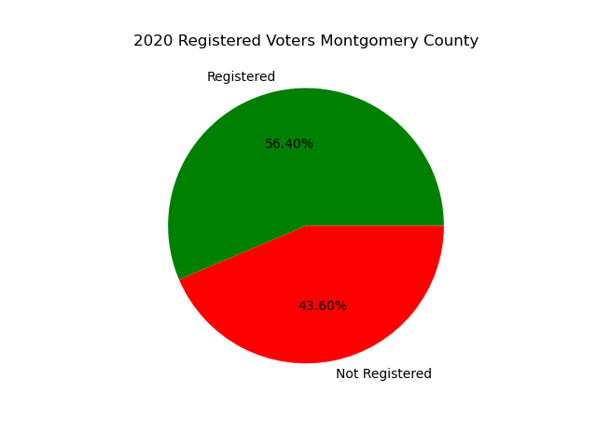
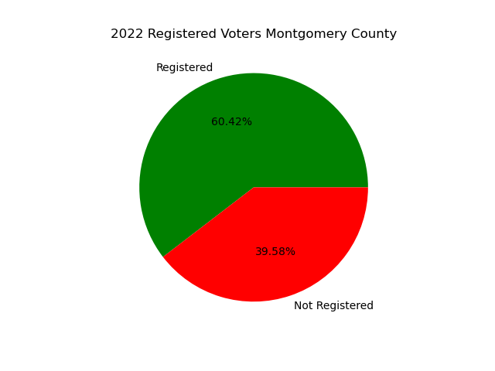
Registered Voters 2020 - 2022

Slide 3
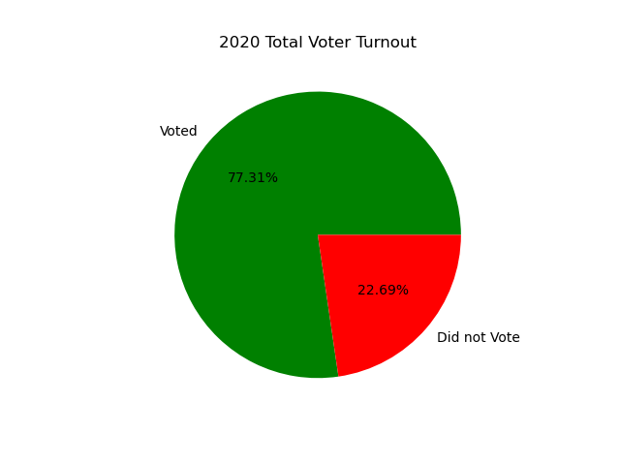
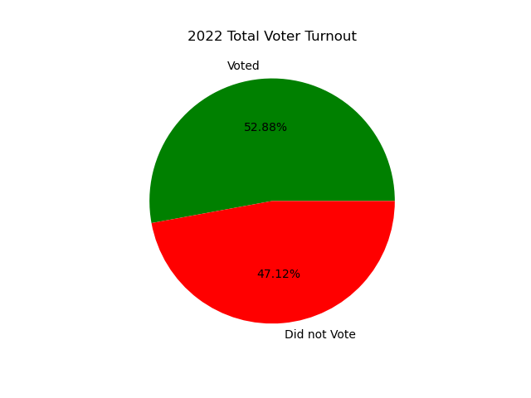
Major Race Turnout 2020 and 2022

Slide 4
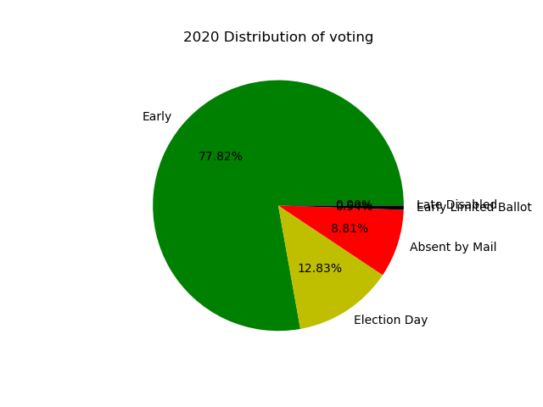
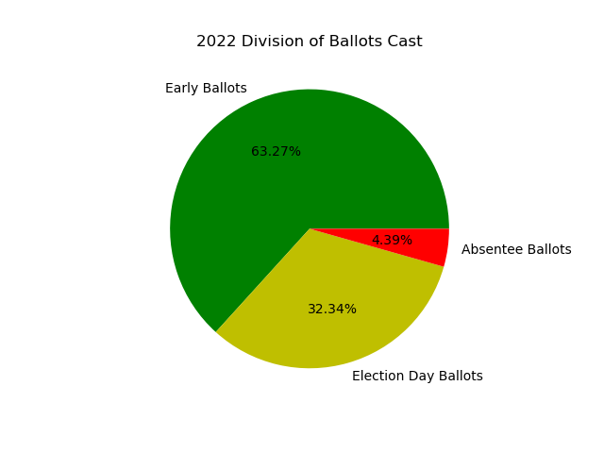
2020 and 2022 Distribution of Ballots Cast

Slide 5
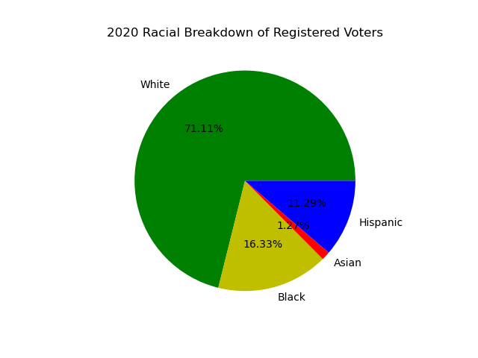

Registered Voters Ethnicity

Slide 6
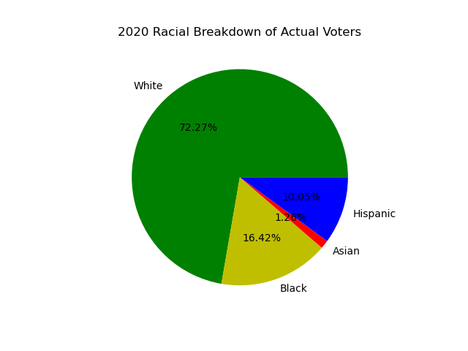
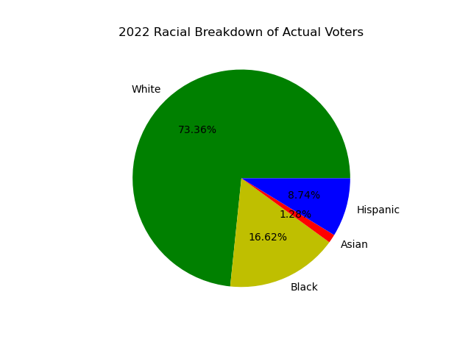
Actual Voters Ethnicity

Slide 7
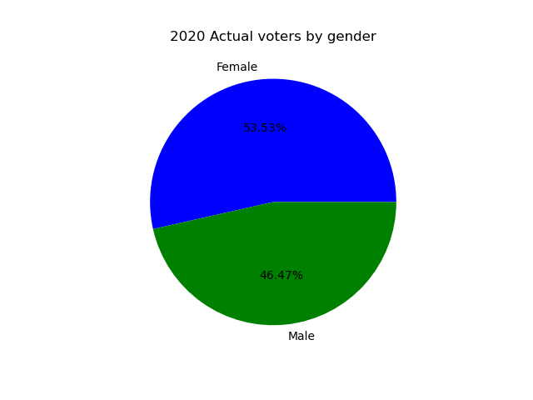
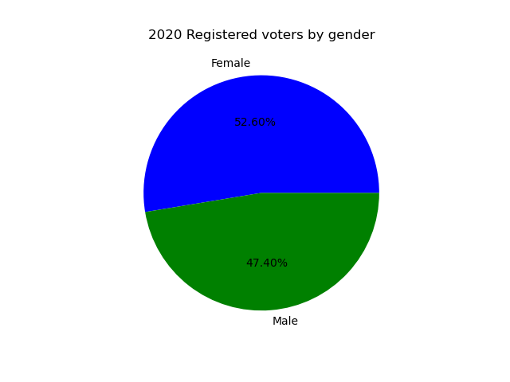
2020 Registered Voters and Actual Voters Gender

Slide 8


2022 Registered Voter and Actual Voters by Gender

Slide 9
Age and Gender of Voters 2020-2022
 | 2020 | 2022
Mean registered voter age | 51.3 | 49.2
Median registered voter age | 51.0 | 49.0
Mean actual voter age | 53.9 | 56.2
Median actual voter age | 55.0 | 57.0
Females(registered Voters) | 179267 | 200038
Males(registered voters) | 161546 | 182610
Females(actual voters) | 126529 | 86444
Males(actual voters) | 109857 | 78200
Difference Females |  | +20771
Difference Males |  | +21067

Slide 10
Mean Difference in age of Actual to Registered Voters 2020 (Top and Bottom 10)
Precinct | Years Difference |  | Precinct | Years Difference
51 | 5.1 |  | 46 | 0.97
75 | 4.7 |  | 87 | 1.09
94 | 4.4 |  | 90 | 1.36
20 | 4.3 |  | 100 | 1.43
44 | 4.1 |  | 99 | 1.47
21 | 4.0 |  | 5 | 1.57
26 | 4.0 |  | 88 | 1.60
52 | 3.9 |  | 96 | 1.61
12 | 3.8 |  | 30 | 1.62
35 | 3.6 |  | 43 | 1.71
All | 2.58

Slide 11
Mean Difference in age of Actual to Registered Voters 2022 (Top and Bottom 10)
Precinct | Years Difference |  | Precinct | Years Difference
54 | 10.6 |  | 5 | 3.3
52 | 9.9 |  | 87 | 3.6
51 | 9.7 |  | 46 | 4.1
75 | 9.7 |  | 90 | 4.2
64 | 9.5 |  | 88 | 4.3
21 | 9.4 |  | 107 | 4.4
44 | 9.4 |  | 4 | 4.5
20 | 9.3 |  | 48 | 4.5
10 | 9.2 |  | 99 | 4.6
84 | 9.2 |  | 100 | 4.7
All | 6.81

Slide 12
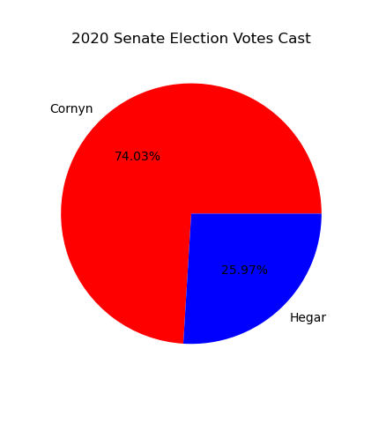
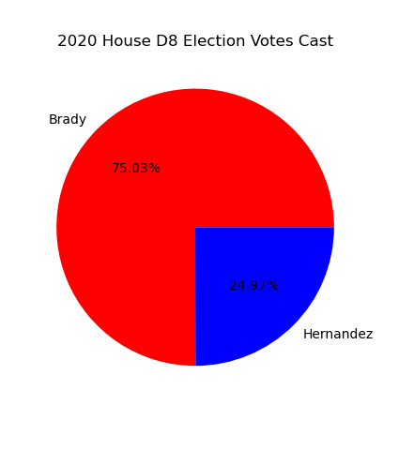
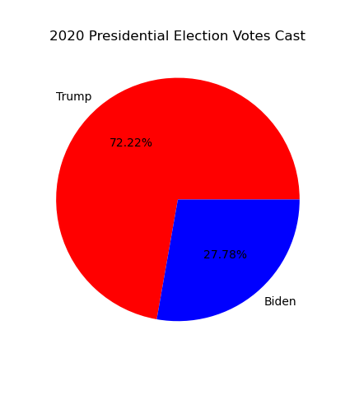
2020 Major County Races

Slide 13

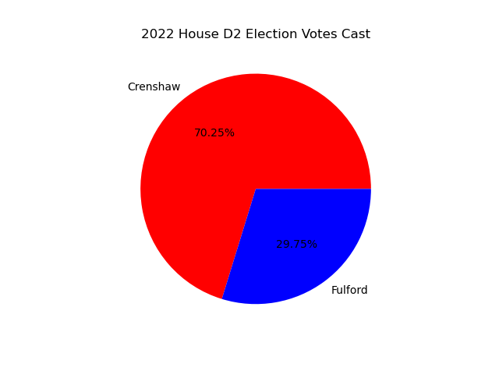


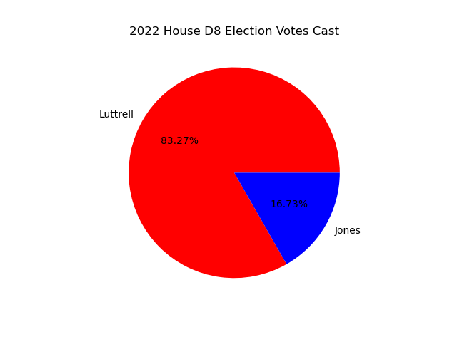
2022 Major County Races

Slide 14
Top 10 Precincts with Positive Change in Republican Voting
Precinct | Percent Change
3 | 7.8
6 | 5.46
25 | 4.37
20 | 4.36
94 | 4.34
19 | 4.27
59 | 3.88
12 | 3.76
85 | 3.67
33 | 3.66

Slide 15
Top 10 Precincts with Positive Change in Democrat Voting
Precinct | Percent Change
1 | 4.86
36 | 4.81
41 | 2.43
47 | 2.41
53 | 2.18
67 | 1.86
37 | 1.10
93 | 1.07
26 | 1.05
42 | 1.01

Slide 16
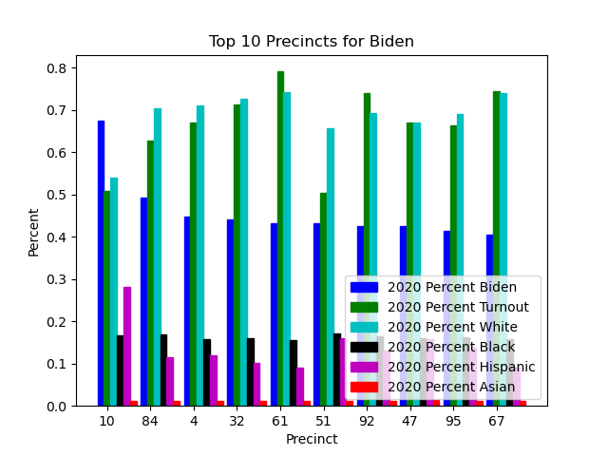
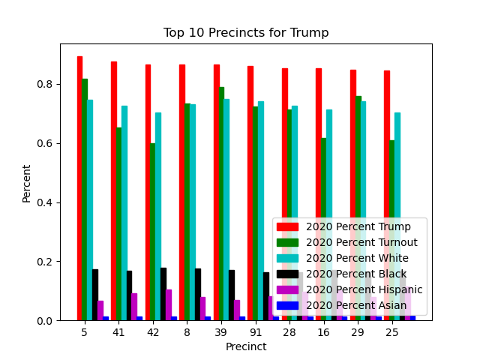
Top 10 Precincts with Demographics 2020

Slide 17
Top 10 Precincts with Age 2020
Precinct | Age |  | Precinct | Age
Biden |  |  | Trump
10 | 50.7 |  | 5 | 58.6
84 | 49.6 |  | 41 | 53.3
4 | 57.4 |  | 42 | 53.3
32 | 55.3 |  | 8 | 54.9
61 | 53.3 |  | 39 | 54.0
51 | 54.5 |  | 91 | 54.0
92 | 48.5 |  | 28 | 54.7
47 | 48.9 |  | 16 | 52.7
95 | 52.2 |  | 29 | 52.8
67 | 56.8 |  | 25 | 54.7

Slide 18
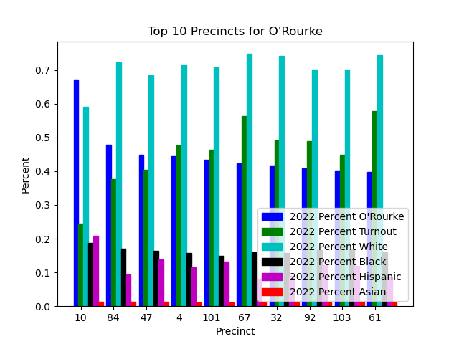
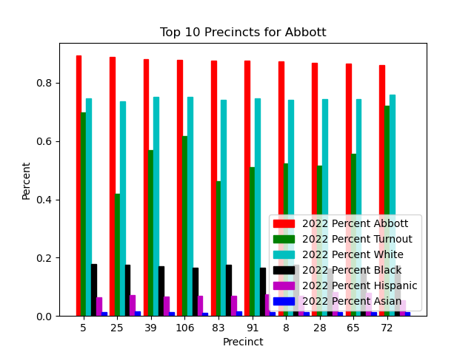
Top 10 Precincts with Demographics 2022

Slide 19
Top 10 Precincts with Age 2022
Precinct | Age |  | Precinct | Age
O’Rourke |  |  | Abbott
10 | 55.2 |  | 5 | 58.0
84 | 53.6 |  | 25 | 58.2
47 | 50.6 |  | 39 | 56.4
4 | 57.8 |  | 106 | 53.0
101 | 52.4 |  | 83 | 57.3
67 | 58.8 |  | 91 | 55.5
32 | 57.7 |  | 8 | 56.3
92 | 50.4 |  | 28 | 56.9
103 | 50.0 |  | 65 | 56.3
61 | 56.1 |  | 72 | 66.0

Slide 20
Pearson Correlation for Major Races
 | Average Hispanic Turnout Correlation
Joe Biden | .47
Beto O’Rourke | .61
Mary Hegar | .51
Mike Collier | .57
Rochelle Garza | .59

Slide 21
Precinct Turnout

Slide 22
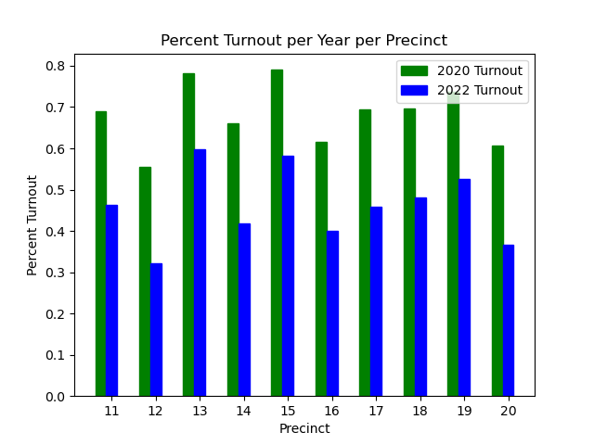
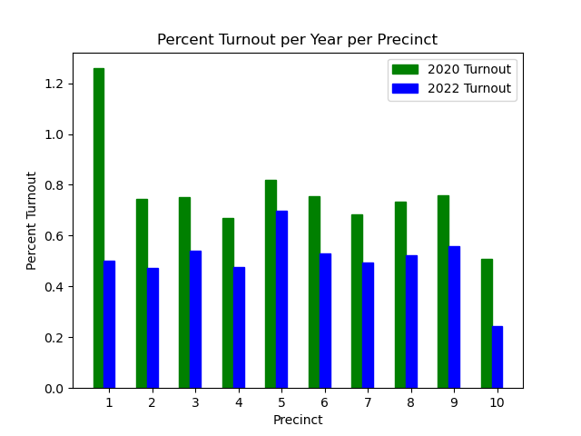
Percent Turnout per Year Precincts 1-20

Slide 23
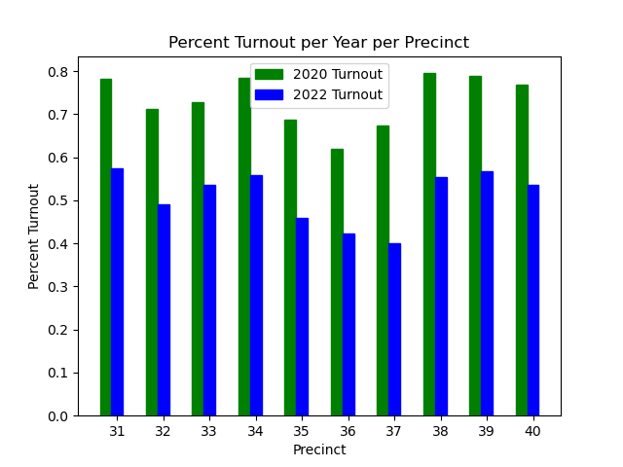
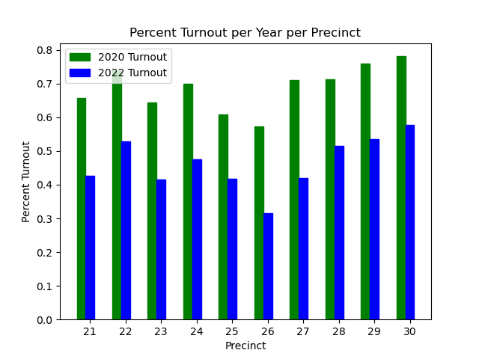
Percent Turnout per Year Precincts 21-40

Slide 24
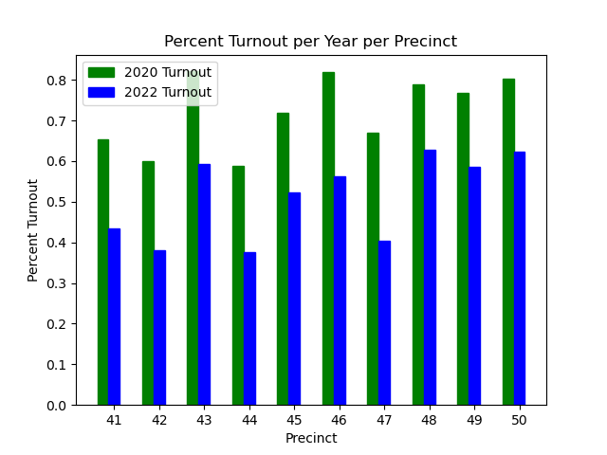
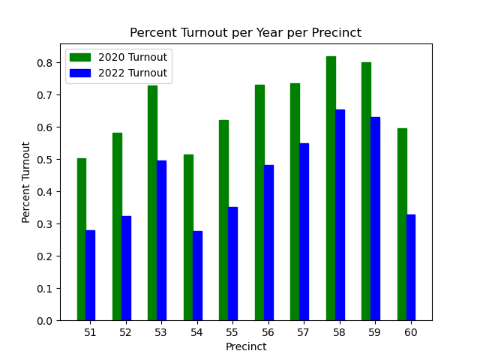
Percent Turnout per Year Precincts 41-60

Slide 25
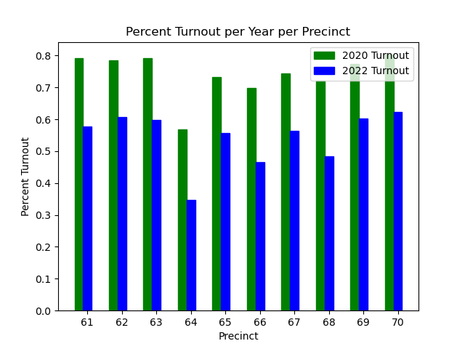
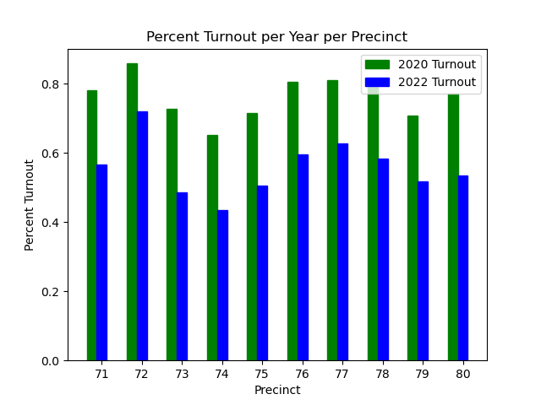
Percent Turnout per Year Precincts 61-80

Slide 26
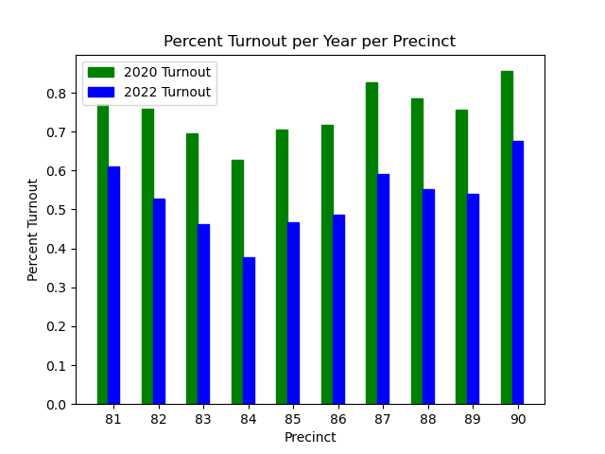
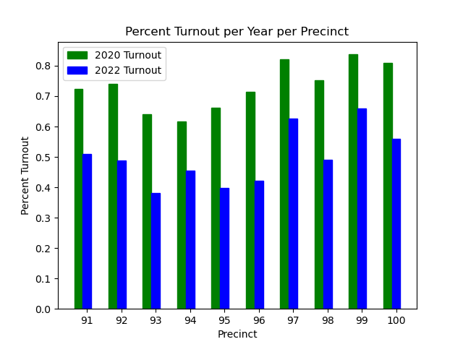
Percent Turnout per Year Precincts 81-100

Slide 27
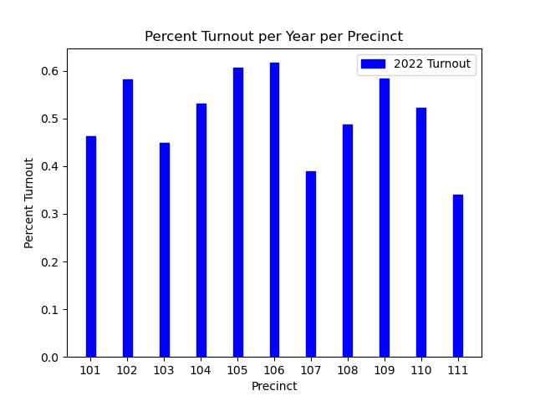
Percent Turnout per Year Precincts 101-111

Slide 28
Voting Age Breakdown

Slide 29
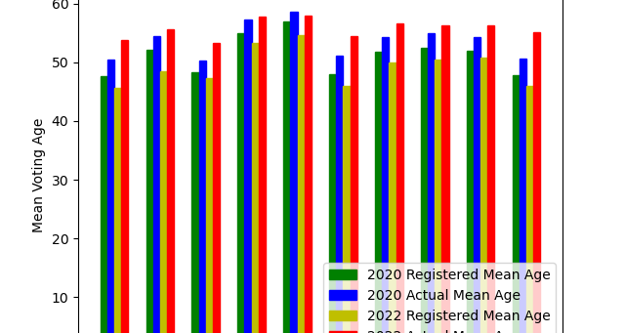
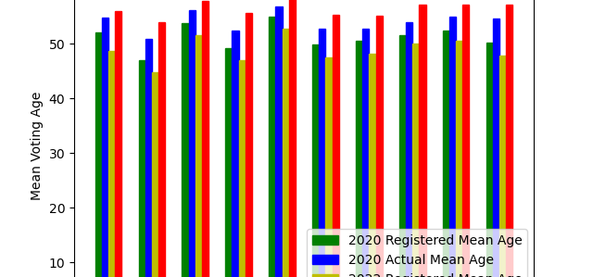
Mean Voting Age by Precinct

Slide 30
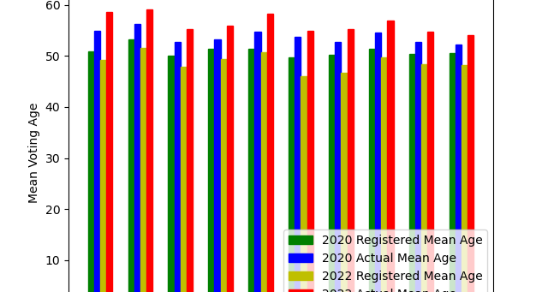
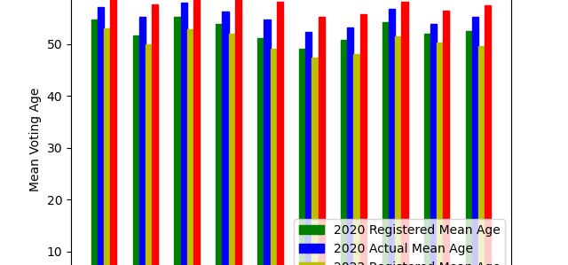
Mean Voting Age by Precinct

Slide 31
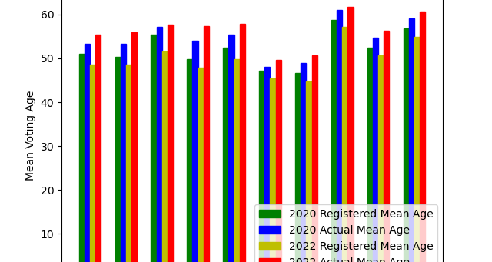
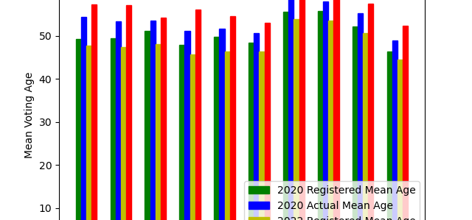
Mean Voting Age by Precinct

Slide 32
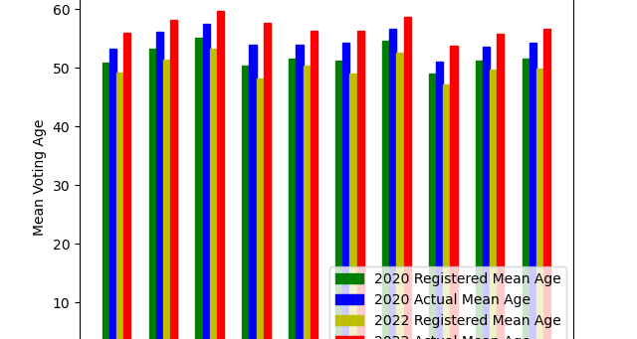
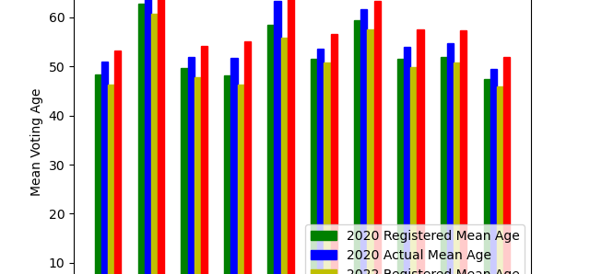
Mean Voting Age by Precinct

Slide 33
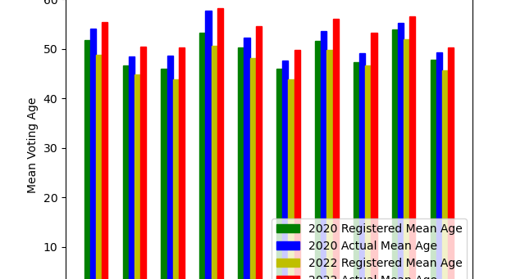
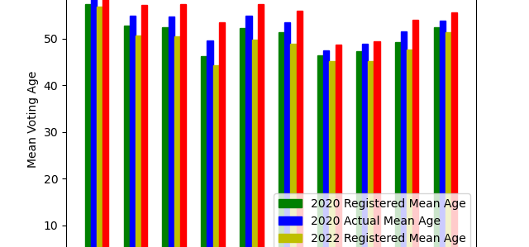
Mean Voting Age by Precinct

Slide 34
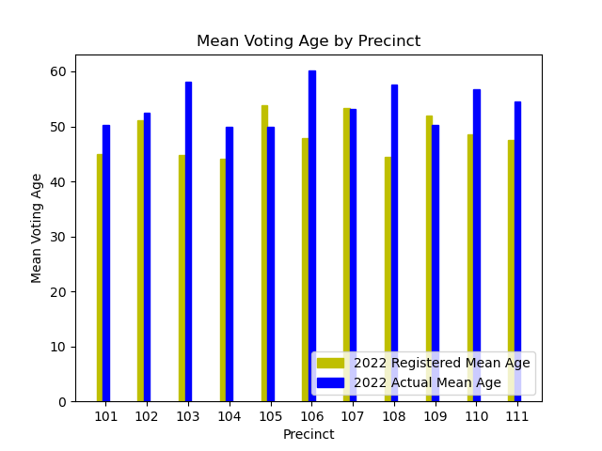
Mean Voting Age by Precinct

Slide 35
Voting Percentages

Slide 36
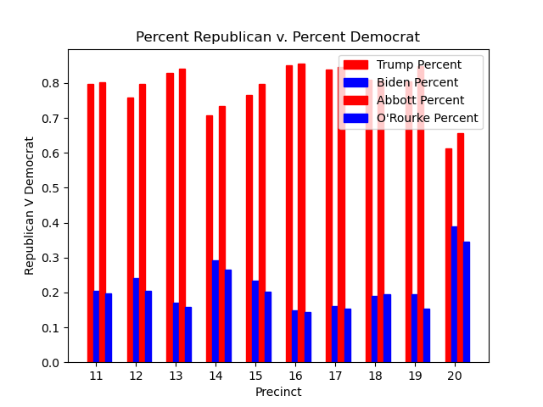
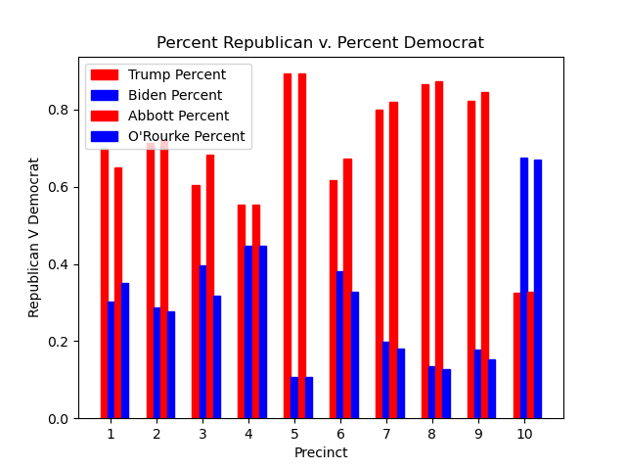
Voting Percentages by Precinct by Year

Slide 37
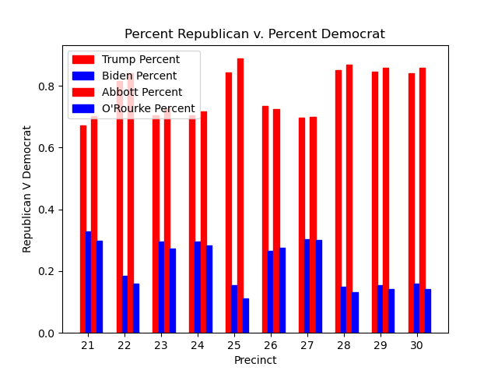
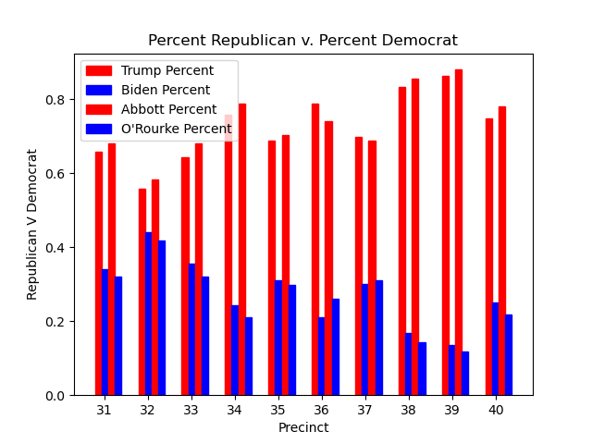
Voting Percentages by Precinct by Year

Slide 38
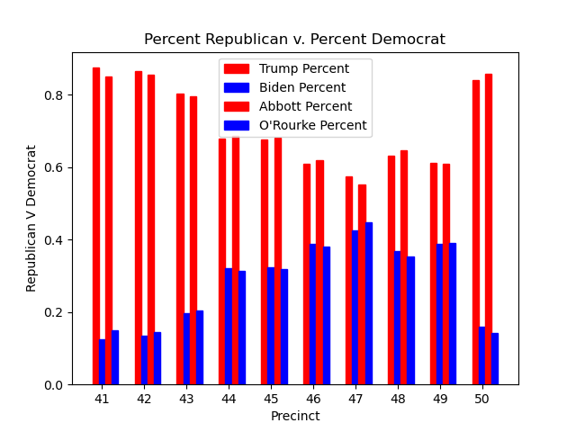
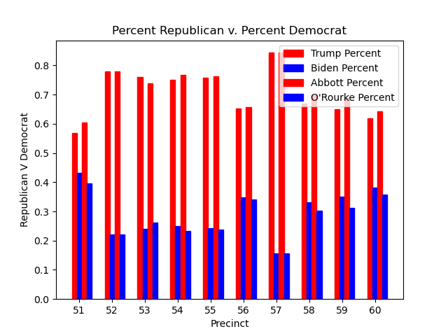
Voting Percentages by Precinct by Year

Slide 39
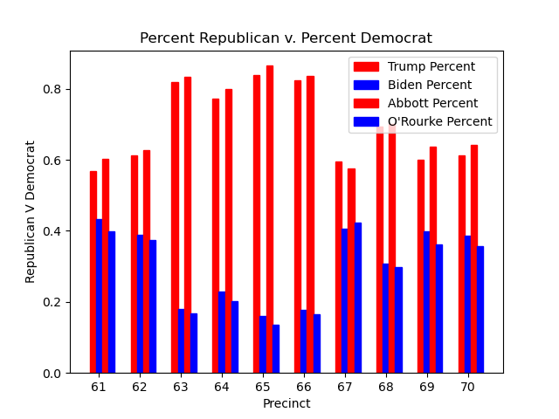
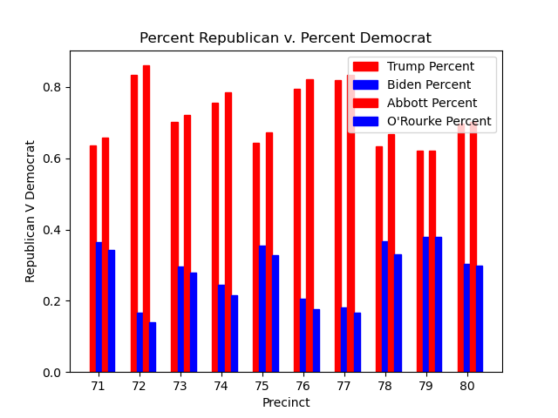
Voting Percentages by Precinct by Year

Slide 40


Voting Percentages by Precinct by Year

Slide 41

Voting Percentages by Precinct by Year

Slide 42
Voting Percent Changes

Slide 43


Change in Voting Percent by Precinct 2020-22

Slide 44


Change in Voting Percent by Precinct 2020-22

Slide 45


Change in Voting Percent by Precinct 2020-22

Slide 46


Change in Voting Percent by Precinct 2020-22

Slide 47


Change in Voting Percent by Precinct 2020-22

Slide 48
Voter Ethnicity

Slide 49
2020

Slide 50


Registered v. Actual Voters Ethnicity by Precinct 2020

Slide 51


Registered v. Actual Voters Ethnicity by Precinct 2020

Slide 52


Registered v. Actual Voters Ethnicity by Precinct 2020

Slide 53


Registered v. Actual Voters Ethnicity by Precinct 2020

Slide 54


Registered v. Actual Voters Ethnicity by Precinct 2020

Slide 55


Registered v. Actual Voters Ethnicity by Precinct 2020

Slide 56


Registered v. Actual Voters Ethnicity by Precinct 2020

Slide 57


Registered v. Actual Voters Ethnicity by Precinct 2020

Slide 58


Registered v. Actual Voters Ethnicity by Precinct 2020

Slide 59


Registered v. Actual Voters Ethnicity by Precinct 2020

Slide 60
2022

Slide 61


Registered v. Actual Voters Ethnicity by Precinct 2022

Slide 62


Registered v. Actual Voters Ethnicity by Precinct 2022

Slide 63


Registered v. Actual Voters Ethnicity by Precinct 2022

Slide 64


Registered v. Actual Voters Ethnicity by Precinct 2022

Slide 65


Registered v. Actual Voters Ethnicity by Precinct 2022

Slide 66


Registered v. Actual Voters Ethnicity by Precinct 2022

Slide 67


Registered v. Actual Voters Ethnicity by Precinct 2022

Slide 68


Registered v. Actual Voters Ethnicity by Precinct 2022

Slide 69


Registered v. Actual Voters Ethnicity by Precinct 2022

Slide 70


Registered v. Actual Voters Ethnicity by Precinct 2022

Slide 71


Registered v. Actual Voters Ethnicity by Precinct 2022

Slide 72
Raw Vote Totals

Slide 73
Raw Vote Totals for Major Races 2020
 | Raw Votes | Percent
Trump | 193382 | 72.22
Biden | 74377 | 27.78
Cornyn | 194528 | 74.03
Hegar | 68254 | 25.97
Brady | 196032 | 75.03
Hernandez | 65242 | 24.97
Crenshaw | 74109 | 70.25
Fulford | 31384 | 29.75

Slide 74
Raw Vote Totals for Major Races 2022
 | Raw Votes | Percentage
Abbott | 152694 | 74.36
O’Rourke | 52654 | 25.64
Luttrell | 81892 | 83.27
Jones | 16456 | 16.73
Patrick | 150172 | 74.07
Collier | 52581 | 25.93
Paxton | 149854 | 74.35
Garza | 51691 | 25.65

Slide 75
2020 and 2022 Distribution of Ballots Cast Raw Numbers
 | 2020 Raw Numbers | 2020 Percent | 2022 Raw Numbers | 2022 Percent | Change
Early in person | 212532 | 77.82 | 131619 | 63.04 | -80913
Election Day in Person | 35032 | 12.83 | 67539 | 32.35 | +32507
Absent by Mail | 24062 | 8.81 | 9175 | 4.39 | -14887
Early Limited Ballot | 1486 | <1 | 435 | <1 | -
Late Death in Family | 0 | 0 | 0 | 0 | -
Late Disabled | 8 | <1 | 2 | <1 | -

